Slide 1
Mastery Based Grading
The Why and the How

Slide 2
Typical Classroom
Student | Assignment #1 35 pts | Assignment #2 14 pts | Assignment #3 28 pts | Grade
Anna | 34 | 14 | 27 | A
John | 0/M | 14 | 28 | F
Beth | 25 | 10 | 24 | C+
Notes:
Look at these three students-Anna has received almost 100% on her assignments and has an A. John has received 100% on his assignments, but is missing one, putting him at an F. Beth has scored in the average range on all of her assignments and has a C+. But the real question is...

Slide 3
What do they really know?

Slide 4
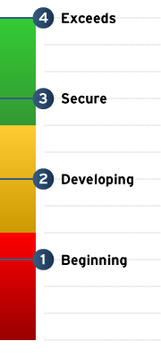
Mastery Based Grading Scale
4=A
3=B
2=C
1=F
Notes:
The idea behind Mastery Based Grading is that students demonstrate their proficiency and mastery of different learning objectives. We use the colors Red, Yellow, and Green to show how students are achieving and corellate them with the numbers 1-4. So let’s look at that same class now using Mastery Based Grading.

Slide 5
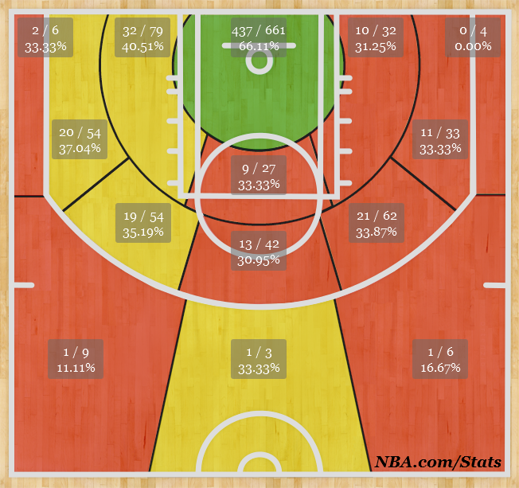
For example...
Notes:
Let’s take a look at a Basketball Shot Chart. By looking at the statistics, the actual taken and missed shots, we can see exactly where the team needs to improve and where they are doing well. Likewise, this is what Mastery Based Grading does. It allows students, parents, and teachers to see where a student is excelling, and where they have room to improve.

Slide 6
Mastery Based Grading Classroom
Student | Learning Objective 1 | Learning Objective 2 | Learning Objective 3 | Grade
Anna | 1 | 3 | 4 | B-
John | 4 | 4 | 4 | A
Beth | 2 | 3 | 2 | C
Notes:
IN a mastery based classroom, students are graded mostly on mastery of their learning objectives. Assignments then become stepping stools for mastery, but are not necessarily proof of mastery. So looking at the class now, we can see that Anna and Beth are struggling with Learning Objective 1, and Beth is still struggling with Learning Objective 3. These students would be given the opportunity to work with teachers to improve and reach proficiency. This can happen even after the class has moved on to other objectives.

Slide 7
What is Mastery Based Grading?
Mastery-Based Grading is a system of reporting student proficiency in a number of specific learning objectives based on the state standards. In each class, the core curriculum is broken down into learning objectives. Students are evaluated on how well they have mastered each of these learning objectives. The student’s grade is a reflection on the mastery level they attain on these learning objectives.

Slide 8
Why Mastery Based Grading?
Educational trends are shifting.
In Utah, some districts and other charters are already moving toward Mastery Based Grading. The benefits for teaching and learning are becoming evident.
Notes:
Fort Herriman Junior High
Copper Mountain Junior High
Herriman High
Canyons School District
American Leadership Academy

Slide 9
What will it change for my student?
In CORE classes (Math, Science, History, and Language Arts), students will be graded off of their proficiency on specific learning objectives.
Students will be able to take more responsibility for their own learning-Mastery Based Grading will make objectives easier to understand and track.
Students will have the ability to work in smaller groups with their teachers on the objectives they are struggling with and on their own timeline.

Slide 10
What will it change for Parents?
Your students gradebook for CORE classes will look different.
You will now know the specific content that your student is struggling with.
Student’s motivation may change from keeping track of assignments to mastering concepts and standards.

Slide 11
What will it look like at ELA?
Implemented in Core subjects: Math, Language Arts, Science, and History grades 7-9
Each class will combine core into learning objective groups
Students will have an evaluation every couple of weeks based off of that learning objective group.

Slide 12
What will it look like at ELA?
Students need to achieve 80% to achieve a 3 (proficiency) and correctly answer an application evaluation to achieve a 4.
Students who do not receive mastery (3 or 4) will receive an “M” so that the evaluation shows as missing until they have achieved proficiency. They will then attend RISE time and have the opportunity to meet with the necessary teachers and work towards proficiency.
All services and accommodations will continue for students with IEPs, 504 plans, or limited English proficiency. Students are evaluated according to the goals of individual plans.

Slide 13
RISE Time!
RISE Time will be held almost weekly
Students who have “M”s will have the time to work in smaller groups with those teachers to work on Mastery and redo Evaluations.
Students with no missing Evaluations will be able to attend an Enrichment activity:
NJHS Peer Tutoring for students who want to push past proficiency and towards mastery
Service activities
Movement based activities
Guest Speakers

Slide 14
Adjusted Grading Scale for Core Classes
Letter grade | Percentage range
A | 93.8-100
A- | 87.5-93.7
B+ | 81.3-87.4
B | 75.0-81.2
B- | 68.8-74.9
C+ | 62.5-68.7
C | 50.0-62.4
C- | 43.8-49.9
D+ | 37.5-43.7
D | 31.3-37.4
D- | 25.0-31.2
F | 0- 24.9

Slide 15
Class Grade Weighting
70%=Standards Proficiency
30%=Projects, Notebook/Notes, Experiments/Essays (to be decided by teachers)

Slide 16
The Bottom Line
This is going to be a change
There will be some bumps in the road, and we may need to make adjustments along the way
But we believe this is going to be beneficial for our kids and beneficial for teaching and learning!

